Slide 1

EXAMGUARD PRESENTATION
Ensuring Integrity in Online & Offline Exams

Slide 2
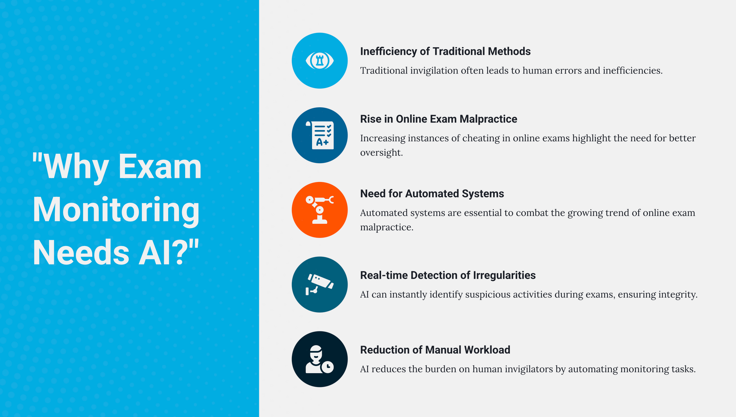

Slide 3

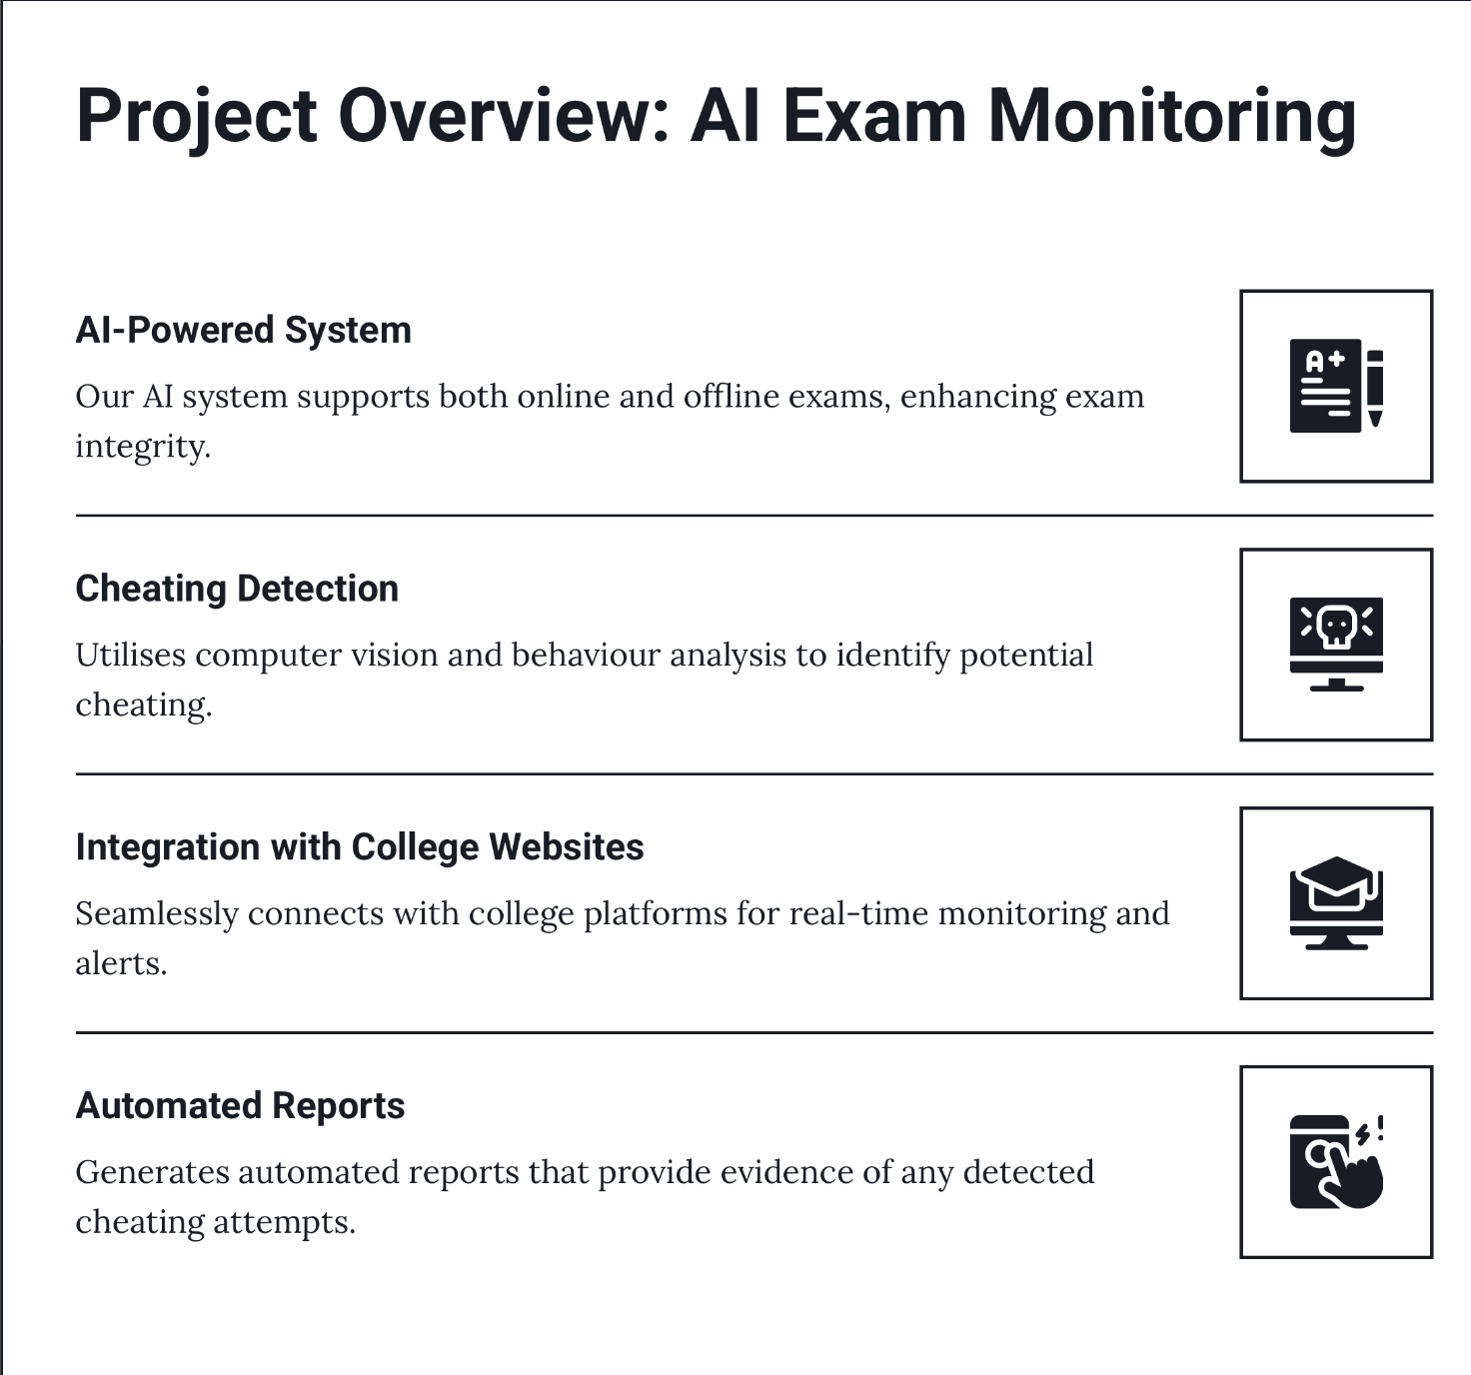
“How Our AI Exam Monitoring Works”

Slide 4

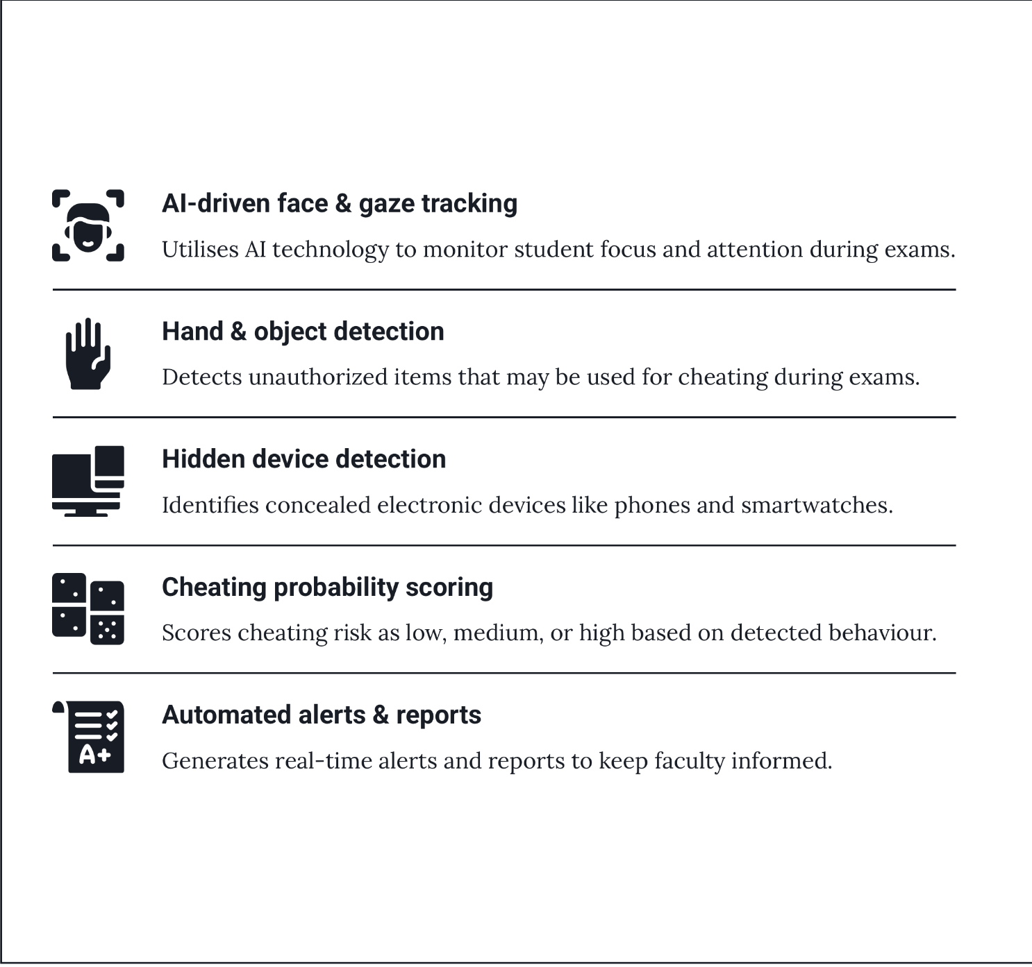
Advanced AI Features for Exam Security

Slide 5
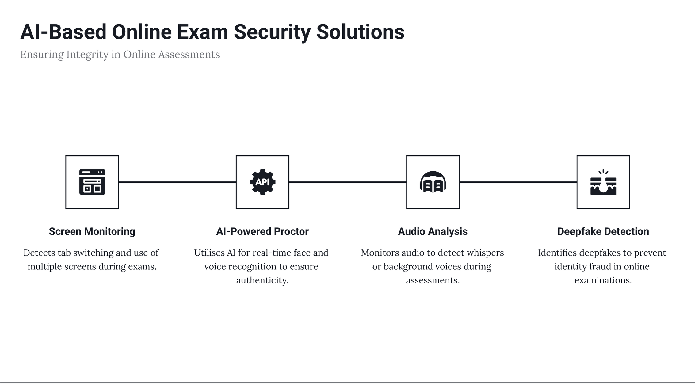
Online Exam Monitoring
"AI-Based Online Exam Security"

Slide 6
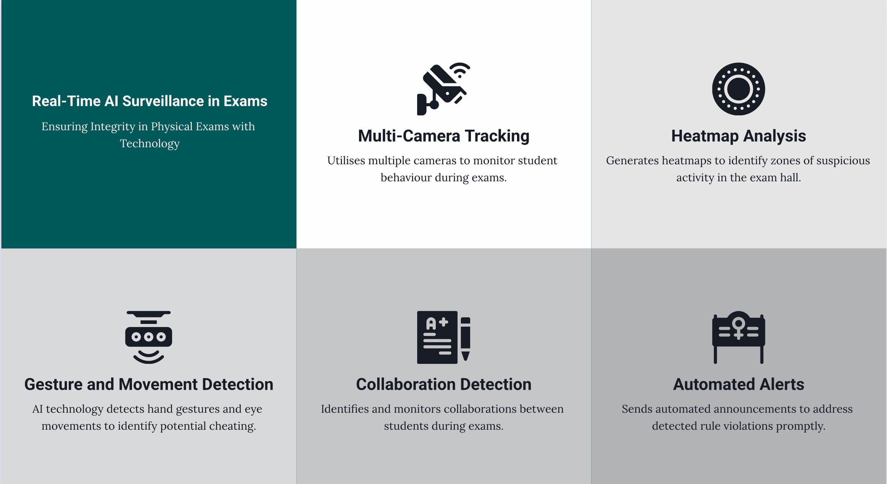

Slide 7
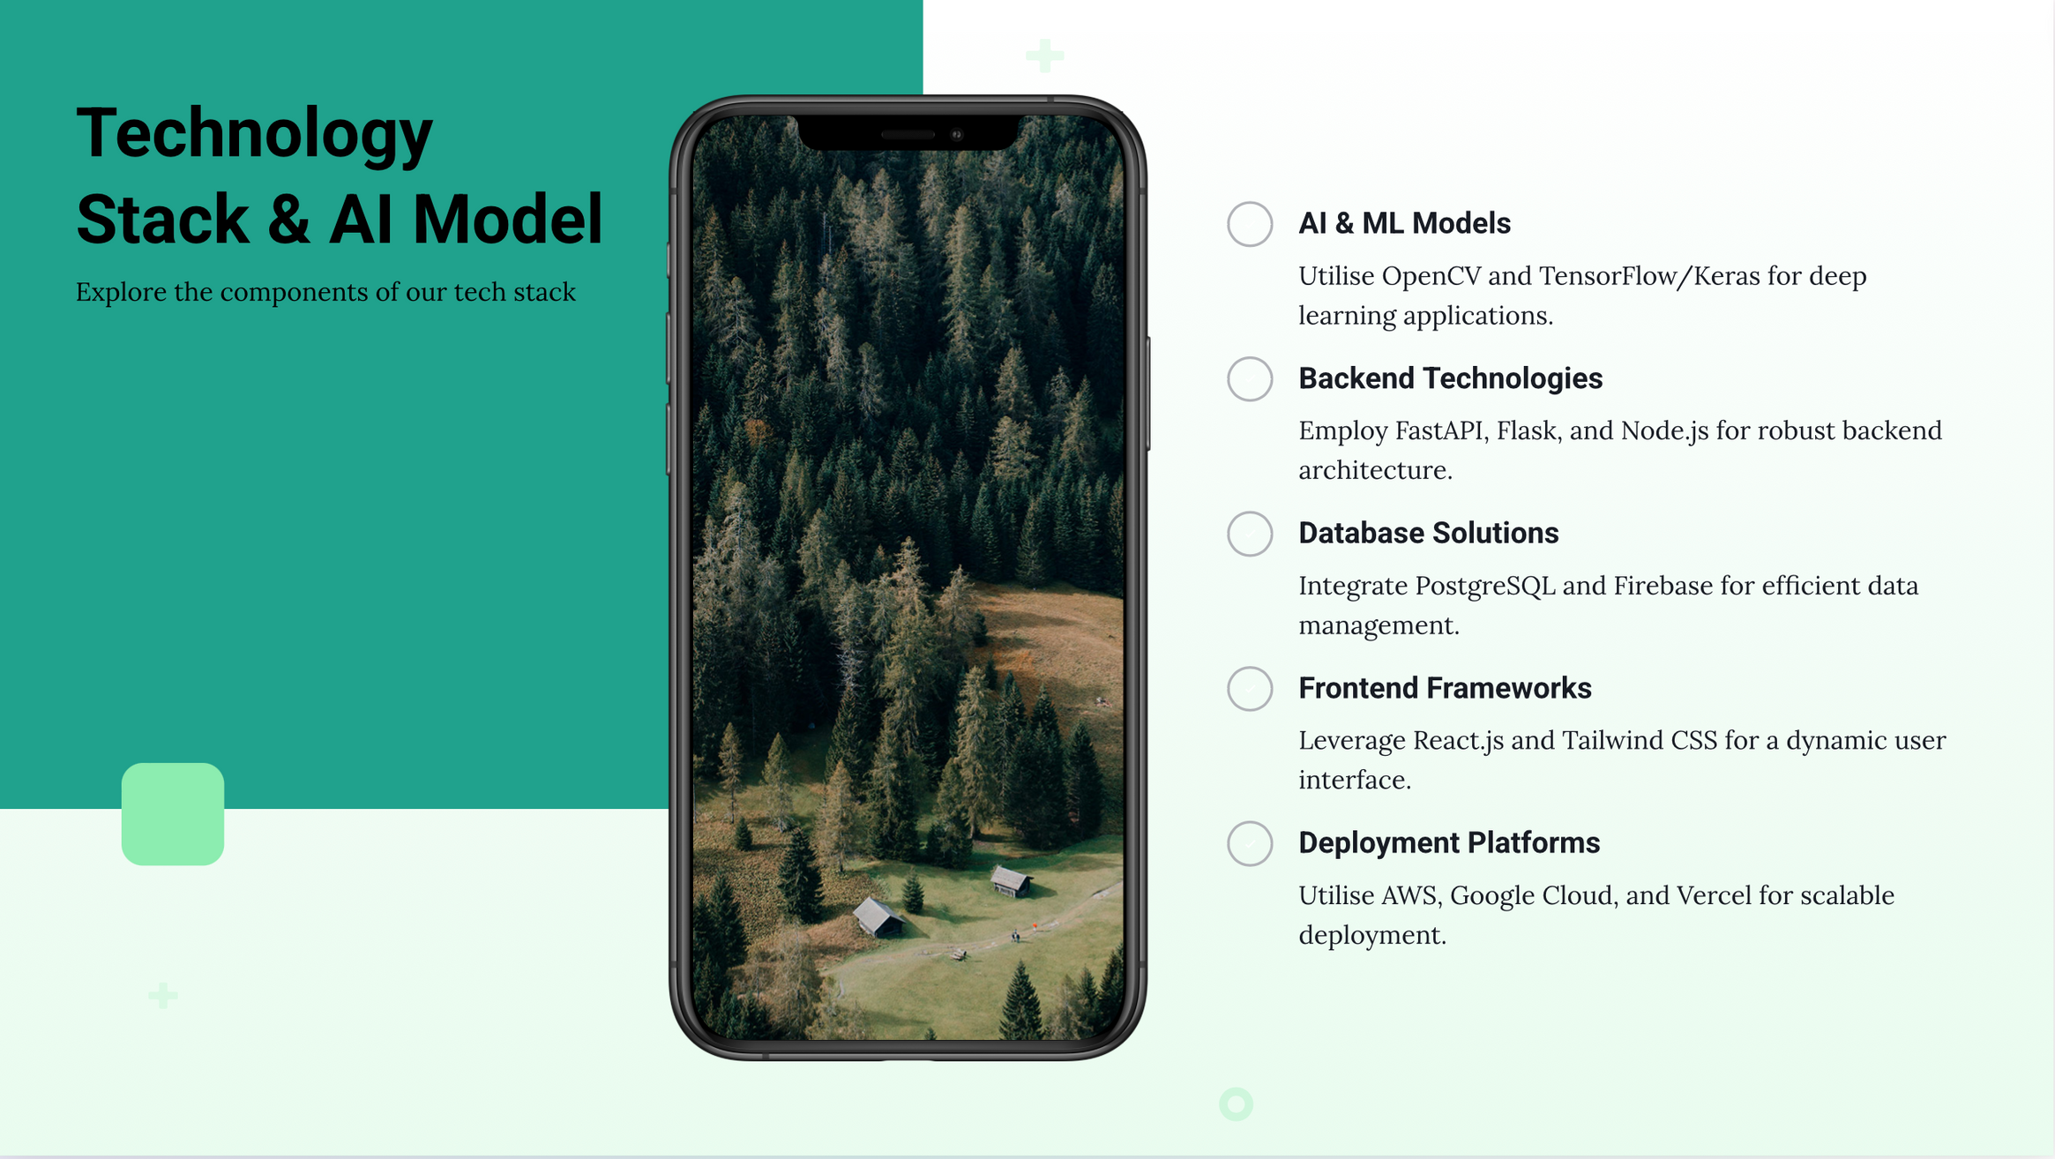

Slide 8
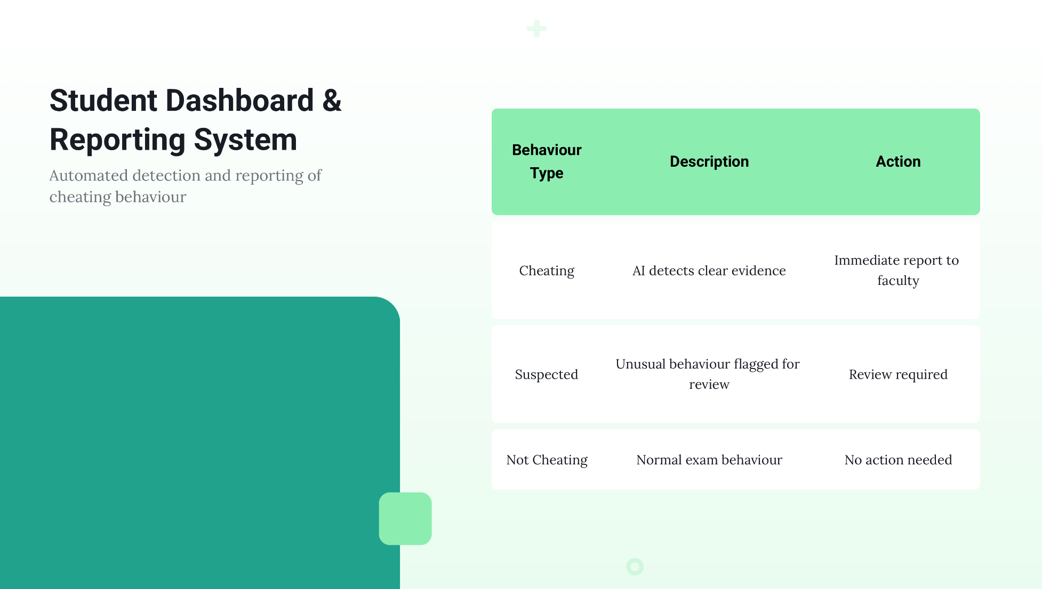

Slide 9

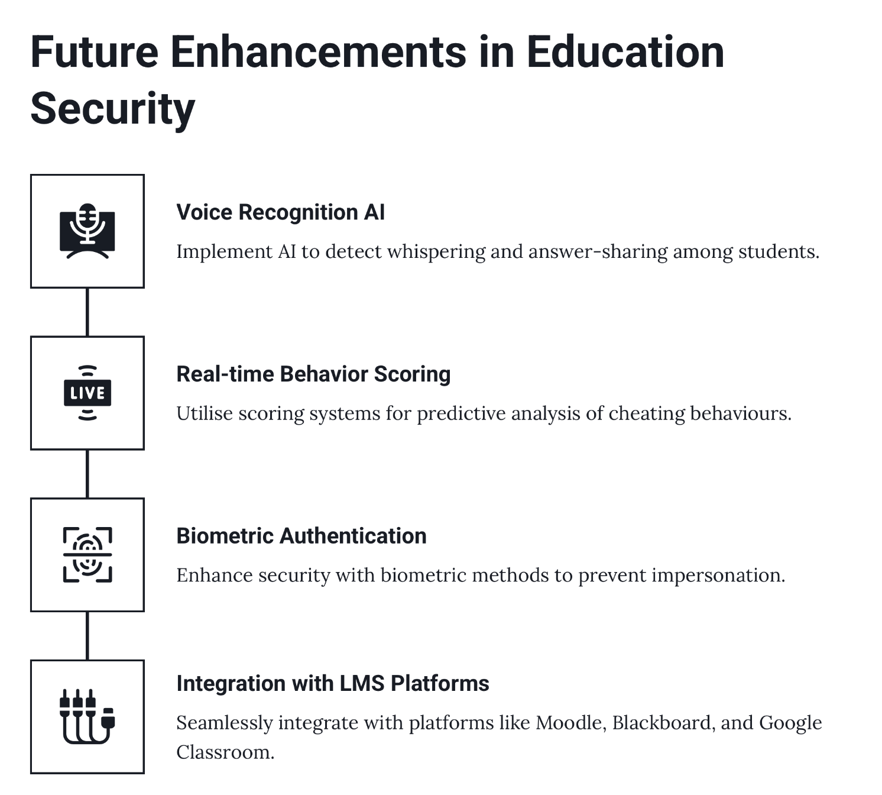
Future Enhancements & Scalability
"Future Roadmap: Scaling AI in Education Security"

Slide 10

CONTACT US
Visit us at
Github Repository

Slide 11
THANK YOU
PATH FINDERS

